Slide 1

Quentin PLA | G1A | Département INFO | IUT Aix-Marseille

Slide 2







Valve Staff Half-Life Steam Loot boxes Innovations
Gabe Newell,
Mike Harrington
24 August
1996
Developper,
Publisher,
Digital distributor
Kirkland,
Washington
(USA)
Bellevue,
Washington
(USA)
$10 billions
(2018)
360 Employees
(2016)
Quentin PLA | G1A | Département INFO | IUT Aix-Marseille
2

Slide 3
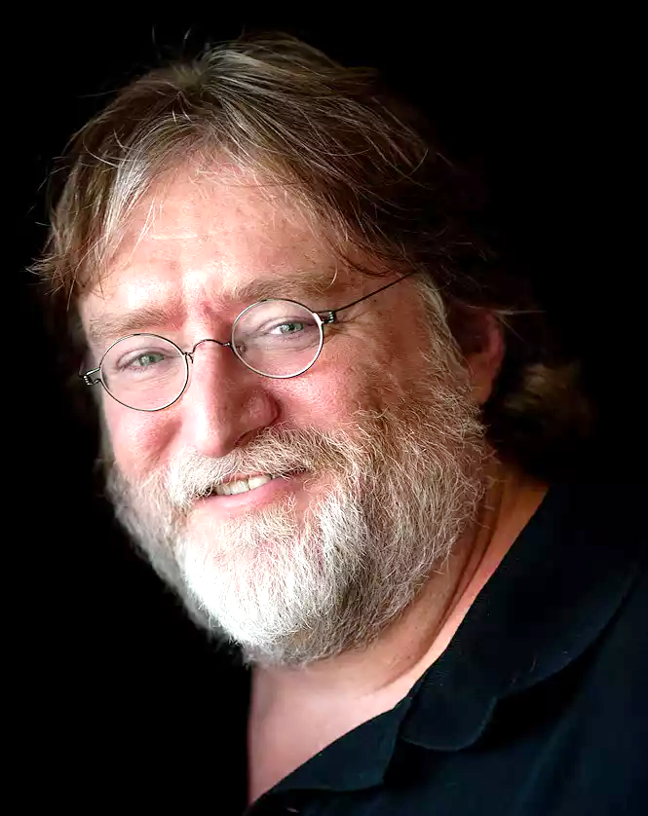





Valve Staff Half-Life Steam Loot boxes Innovations
Gabe logan Newell
November 3
1962
American
nationality
Harvard University
(early 1980s)
Computer programmer,
businessman
Microsoft employee
Co-founder of Valve Corporation (1996)
President of Valve Corporation (2000 - 2018)
Quentin PLA | G1A | Département INFO | IUT Aix-Marseille
3

Slide 4

Valve Staff Half-Life Steam Loot boxes Innovations
Mike Harrington
American
nationality
Computer programmer
Microsoft employee (1987 - 1996)
Co-founder of Valve Corporation (1996 - 2000)
Quentin PLA | G1A | Département INFO | IUT Aix-Marseille
4

Slide 5

Valve Staff Half-Life Steam Loot boxes Innovations
Scott Lynch
April 2
1978
American
nationality
Fantasy Author
Chief operating officer of Valve Corporation (2000 - 2018)
Quentin PLA | G1A | Département INFO | IUT Aix-Marseille
5

Slide 6
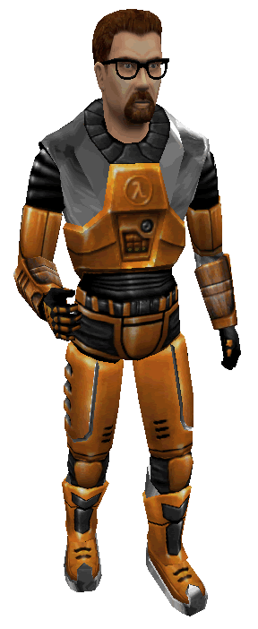

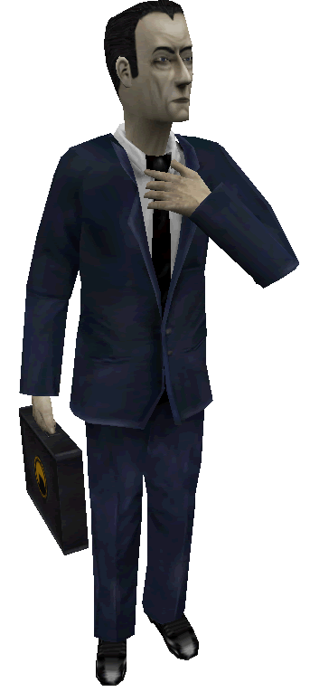
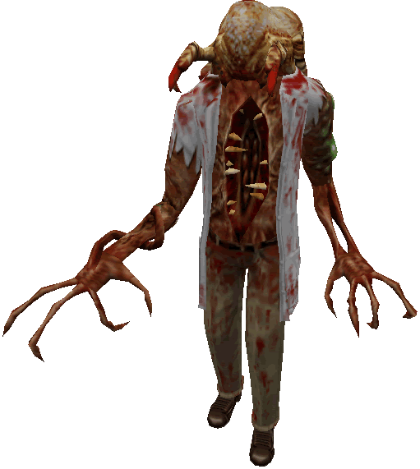
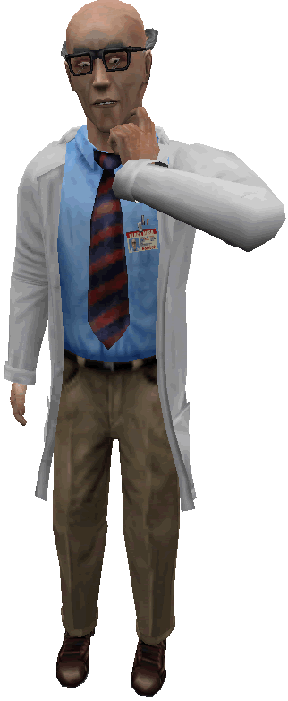



Valve Staff Half-Life Steam Loot boxes Innovations
FPS
November 19
1998
15 millions units
Sold (since 1998)
$25,5 millions
(USA, 2000)
Excellent
critics
Quentin PLA | G1A | Département INFO | IUT Aix-Marseille
6

Slide 7


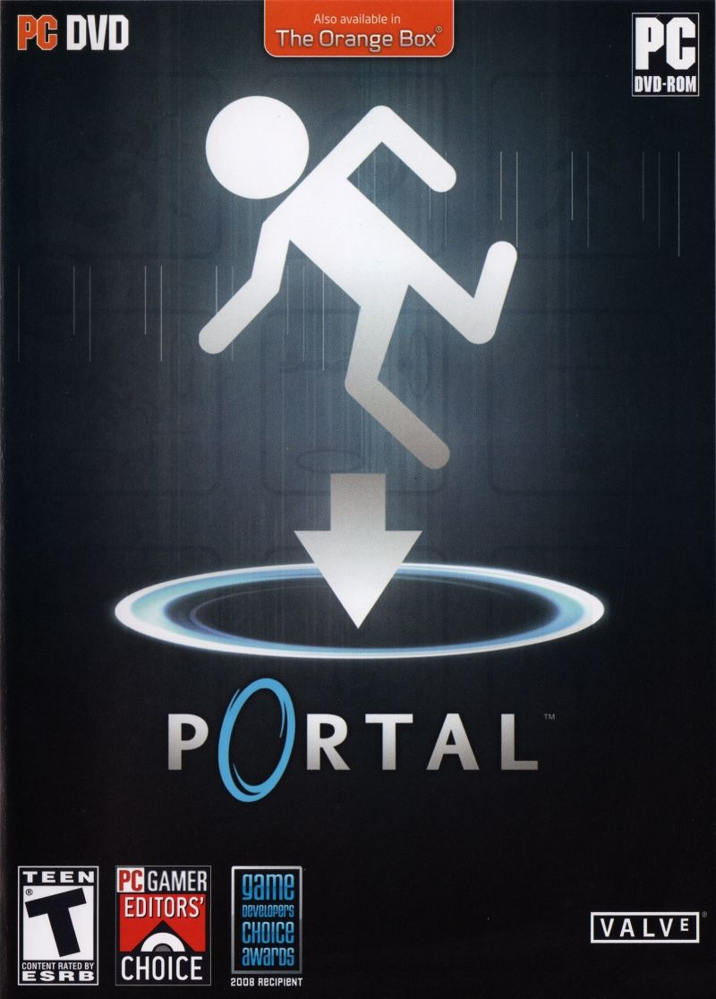



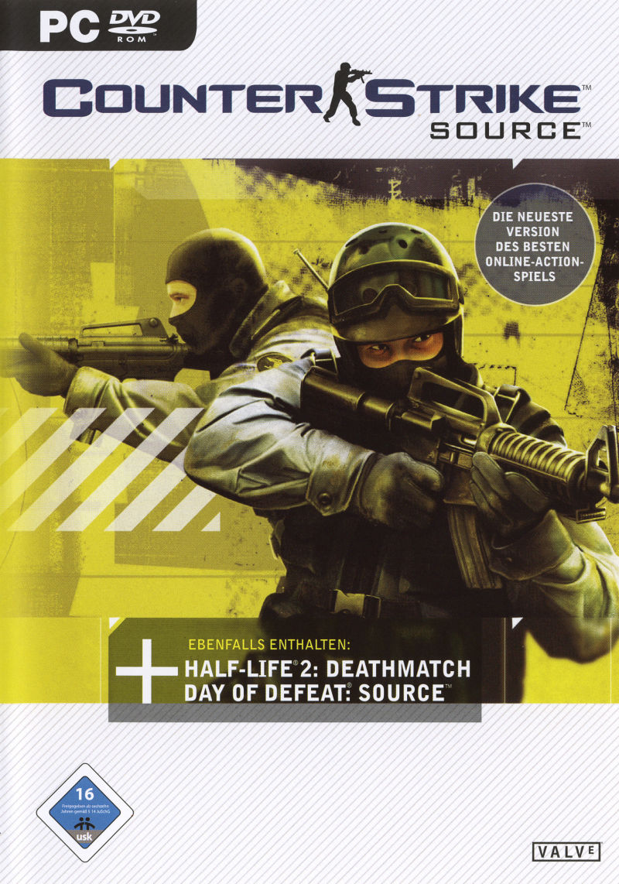




Valve Staff Half-Life Steam Loot boxes Innovations
Software
Content deliver
Digital rights manager
Social network service
Video streaming service
September 11
2003
$4,3 billions
(2017)
Quentin PLA | G1A | Département INFO | IUT Aix-Marseille
7

Slide 8
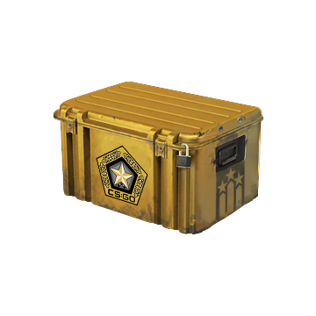
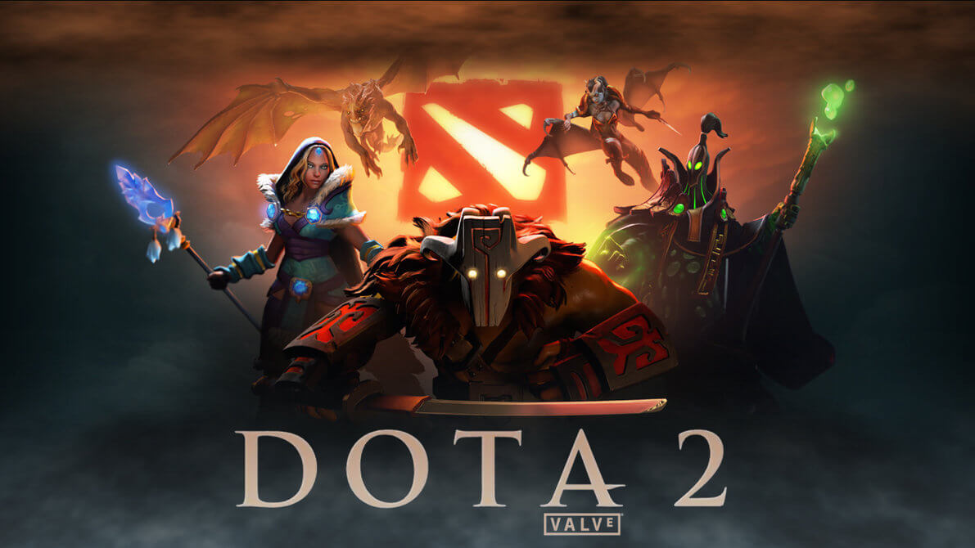
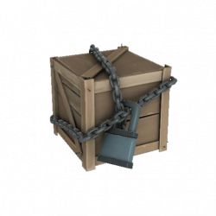
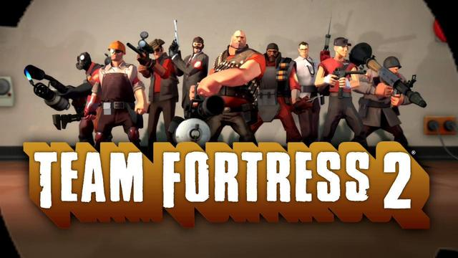
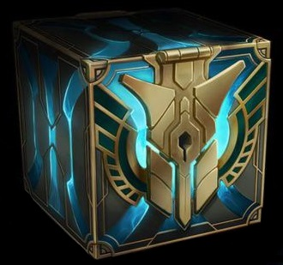
Valve Staff Half-Life Steam Loot boxes Innovations
Loot boxes
Quentin PLA | G1A | Département INFO | IUT Aix-Marseille
8

Slide 9
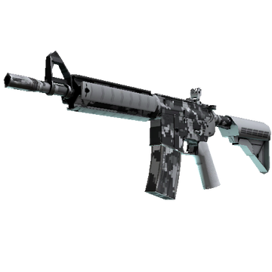
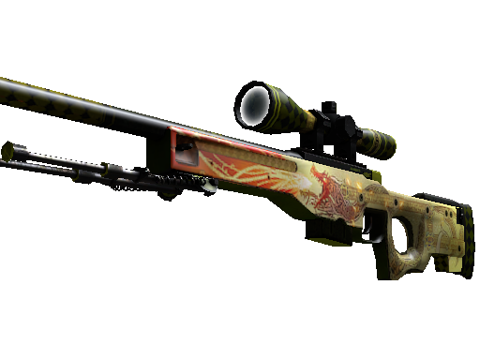
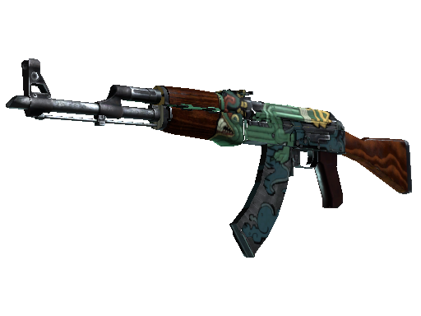
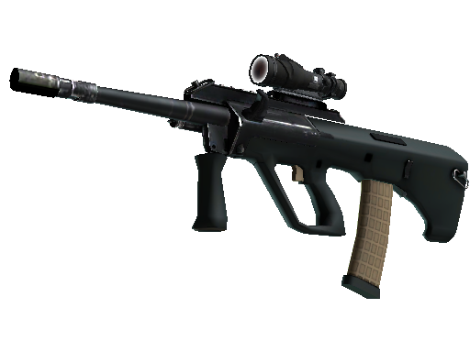
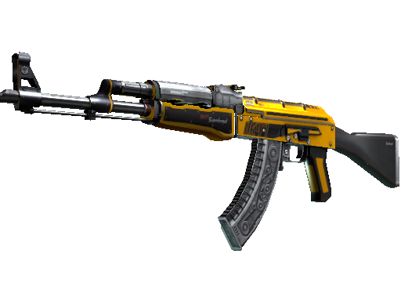
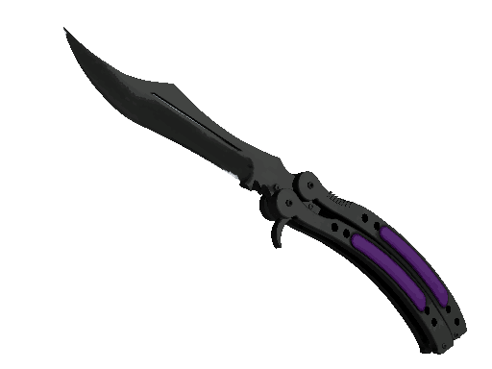

Valve Staff Half-Life Steam Loot boxes Innovations
Battle Scared
Field-Tested
Minimal Wear
Minimal Wear
Battle Scared
Factory New
Battle Scared
Well-Worn
Minimal Wear
Factory New
Battle Scared
Quentin PLA | G1A | Département INFO | IUT Aix-Marseille
9

Slide 10
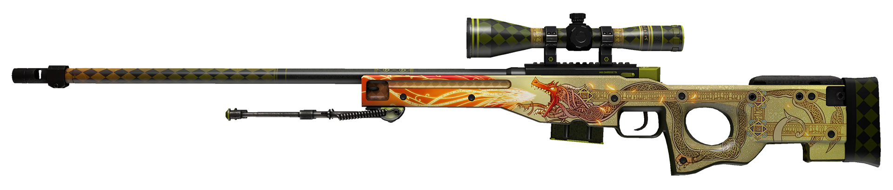

Valve Staff Half-Life Steam Loot boxes Innovations
$400 - $1200
$26 - $476
$0,15 - $71
$110 - $1500
$0,03 - $5
$140 - $300
Quentin PLA | G1A | Département INFO | IUT Aix-Marseille
10

Slide 11
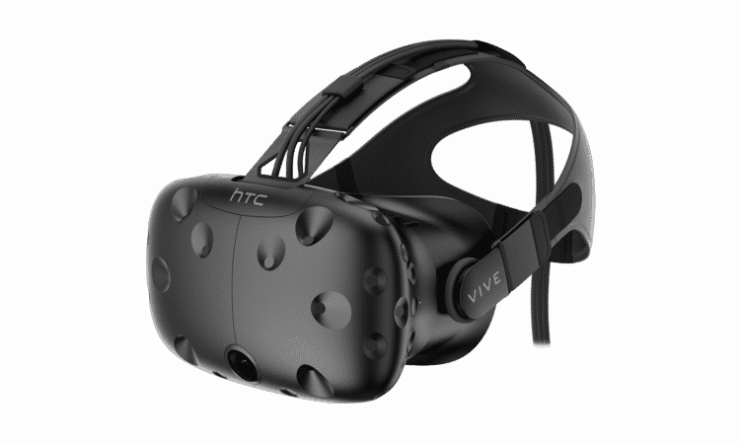
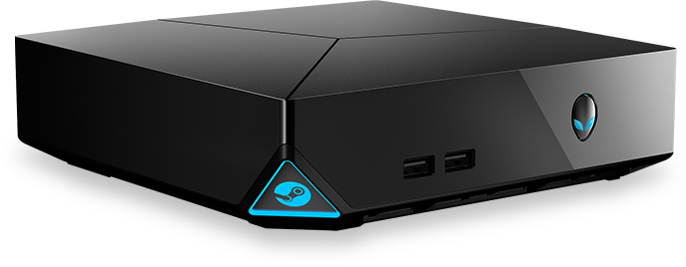
Valve Staff Half-Life Steam Loot boxes Innovations
Innovations
Steam machine
HTC Vive
Quentin PLA | G1A | Département INFO | IUT Aix-Marseille
11

Slide 12
Valve Staff Half-Life Steam Loot boxes Innovations
Thanks for your attention.
Quentin PLA | G1A | Département INFO | IUT Aix-Marseille
12

